Slide 1



CAAFI 2014
General Meeting
& Expo
Government Partners’ Activities Update
Moderated by: Steve Csonka, Executive Director, CAAFI
Produced by

Slide 2
CAAFI 2014
General Meeting
& Expo
Lourdes Maurice, Executive Director for Environment
and Energy, FAA
Produced by

Slide 3
Overview of FAA Alternative Jet Fuel Efforts
By: Dr. Lourdes Maurice
Executive Director
Office of Environment and Energy
Federal Aviation Administration
Date: January 28, 2014

Slide 4
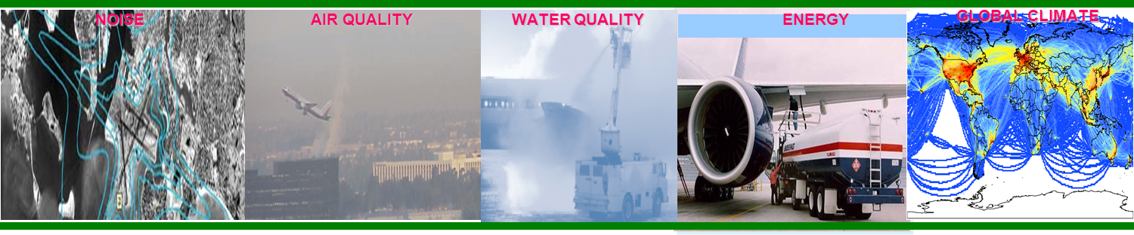
Aviation Environmental Challenges
NOISE AIR QUALITY WATER QUALITY ENERGY GLOBAL CLIMATE
Aviation impacts community noise, air quality, water quality, energy usage, and climate change
Environmental impacts from aviation emissions could pose a critical constraint on capacity growth
Alternative jet fuels could reduce the environmental impact of aviation:
  Carbon neutral growth by 2020 compared to 2005
  1 billion gallons of renewable jet fuel in use by aviation by 2018
  Absolute reduction of significant air quality impacts, notwithstanding aviation growth

Slide 5
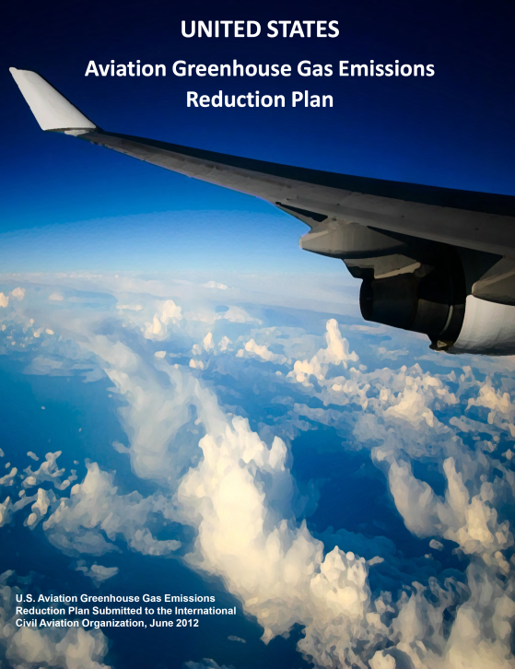
U.S. Climate Action Plan for Aviation
The U.S. is pursing a multipronged approach to address green house gas emissions from aviation
  Aircraft and engine technology improvement
  Operational improvements
  Alternative fuels development and deployment
  Policies, environmental standards, and market based measures
  Scientific understanding through research, modeling and analysis
Notes:
This mirrors the NextGen Five Pillars

Slide 6
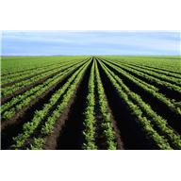



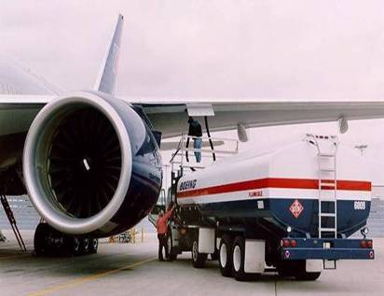
Challenges for Sustainable Alternative Fuels
Feedstock availability
Competitive cost for alternative fuel
Approved for performance/safety
Environmentally sustainable
Commercially produced
Notes:
The problem statement
The most salient barriers/risk to successful development and deployment are:
having enough of a non-food (advanced) feedstock to supply production
Achieving cost competitive alt. fuels – we have R&D levers on feedstock and conversion process
Safety is assumed – but process needs to be facilitated
Folks have noted that uncertainties in both measuring and comparing/certifying env. Impacts is a concern
Unlocking private secotr investment for early production facilities

Slide 7





Current FAA Alternative Jet Fuel Activities
Testing
  Material compatibility
  Certification / Qualification
  Emissions measurements
Analysis
  Environmental sustainability
  Techno-economic analysis
  Future scenarios
Coordination
  Public-Private
  State & Regional
  International
Notes:
R&D portfolio is to advance our understanding and play our role as a facilitator of the process
Loosely grouped into four categories:
Performance and emissions Testing of Alternative fuels to support ASTM approval and emission benefits measurement
Analysis on impacts, economics and availability to Improve our understanding and decision making
Coordination and Leveraging efforts across…public-private, interagency, government and with international partners
Tracking Fuel Use by U.S. aviation to measure progress towards our goals – we work with Airlines for America and the Defense Logistics Agency – Energy to count gallons of fuel used
Our means of conducting the work on the right side

Slide 8
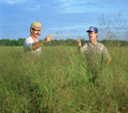
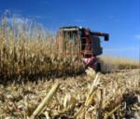

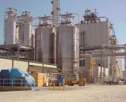
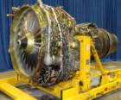










Coordinating Agency Efforts across Supply Chain
Facilitating Deployment and Investment
Feedstock
Production
Feedstock
Logistics
Conversion Process Scale-up/Integration
Fuel Testing / Approval
Fuel
Conversion
Enable Production
End User/ Buyer
Fuel Performance | Environment Assmt
Agriculture: Biomass Crop Assistance Program & Crop Insurance Program
Energy & Defense: R&D grants
Agriculture& Energy: R&D grants
FAA & Defense: C/Q Fuel testing
FAA, Defense, & NASA: Enviro Analysis
Agriculture, Navy, & Energy: Defense Production Act and Biorefinery Program
Defense & Airlines: fuel purchase
Agriculture: Feedstock Development Center Grants
FAA: Guidance for Airports
EPA: Renewable Fuel Standard
Notes:
8
This is a broad effort & Success Requires coordination across supply chain.
We are depending on the program, policies and expertise of 8 different agencies (USDA, DOE, DoD, EPA, NASA, Commerce and NSF)
We are working together to Develop and National Strategy for Alternative Jet fuel R&D – you will hear more tomorrow.
This provides an across government perspective and sense of who and how each agency is providing support through policy or programs.
----
Supply chain columns:
Feedstock production –- identification, assessment and improvement of potential jet fuel feedstock crops
Feedstock logistics— support for harvesting/movement of the feedstock to where it needs to be
Fuel Conversion—R&D to develop and optimize alternative jet fuel conversion processes
Conv. Process and scale up – out of lab and pushing towards commercialization—prove scaled production
Fuel performance—how engine/a/c perfomr using the fuel → key to qualification and certification
Env. Assessment—air quality improvements & GHG LCA
Enable Production—govt. incentives to support a new industry such as USDA and DOE loan guarantee and grant program, RFS2, DOC investor education/webinars
End user—Agencies that use fuels (DoD), and in case of airlines (close coordination with fAA)

Slide 9


Commercial Aviation Alternative Fuels Initiative
Public-Private coalition for commercial aviation to engage the emerging alternative fuels industry
Coordinate development of alt jet fuels:
  Equivalent safety/performance (drop-in)
  Comparable cost
  Environmental improvement
  Security of Energy supply
Four teams for key issues:
  Environment Team
  Certification-Qualification Team
  R&D Team
  Business Team
State and Regional Support
International Cooperation
Notes:
CAAFI is a Government-Industry-Academia Coalition & Public – Private partnership.
Technology neutral – solutions must meet the listed criteria
CAAFI Enables diverse participants to build relationships, share and collect data, identify resources, and direct research, development and deployment of alternative jet fuels.
Key issues being addressed in regular meetings of four teams
It also allows private sector to own the effort and coordinate closely with USG.
CAAFI is focusing efforts on development of supply at a state and regional level
CAAFI also facilitates international cooperation

Slide 10












International Engagement
Bilateral Cooperation Agreements
Coordination with counterparts, and R&D organizations
U.N. International Civil Aviation Organization
Australia
Brazil
Germany
Spain
Notes:
This effort is truly a global one
There are many different initiatives emerging – including public-private partnerships, public led R&D initiatives, private led initiatives, and supply chain efforts
FAA has been working to coordinate both formally and informally with these efforts in other countries.
We have formal coordination via Govt. to govt. bilateral agreements with Australia, Brazil, Germany and Spain. These are non-binding cooperative agreements that provide an umbrella for public-private sector activity and mutual strengthening at policy making level.
Informal coordination with our counterparts in other governments and with R&D funding organizations.
And we also support and participate with the United Nation’s International Civil Aviation Organization in it’s role as a forum for exchange of best practices among member States.
This includes participation on a newly established ICAO Committee on Aviation Environmental Protection (CAEP) Alternative Fuels Task Force
[flags on bottom are European Union, Canada, China, France, Netherlands, Mexico and Indonesia]

Slide 11


New FAA Programs
Aviation Sustainability Center (ASCENT)
New CoE for Alternative jet fuel and Environment
Ten technical areas covering alt fuels and environment
WSU and MIT leading team of Universities
Continuous Lower Energy, Emissions and Noise (CLEEN) II
CLEEN I: 2010-2015 effort
CLEEN II: solicitation 2014; program covers May 2015-2020.
Reduce aircraft fuel burn, emissions and noise through technology & advance alternative jet fuels
Spring 2014 Screening Information Request
Notes:
COE Technical Areas – Alt Jet Fuels
Feedstock Development, Processing and Conversion Research
Regional Supply and Refining Infrastructure
Environmental Benefits Analysis
Aircraft Component Deterioration and Wear Assessment
Fuel Performance Testing
COE Technical Areas – Environment
Aircraft Noise and Impacts
Aviation Emissions and Impacts
Aviation Modeling and Analysis
Aircraft Technology Assessment
Environmentally and Energy Efficient Gate-to-Gate Aircraft Operations

Slide 12
Summary
Advancing use of alternative jet fuels is key for meeting U.S. environmental goals
Testing & demo efforts accelerate alt fuel technology development
Analysis efforts improve environmental impacts and economic quantification and decision-making
Continuing coordination among government agencies, with private sector and across the supply chain is key to deployment
International cooperation key to leverage diverse efforts
Development of supply to meet needs is next big challenge
Notes:
Alternative jet fuels is key for meeting U.S. environmental goals
COE Testing & demo efforts will accelerate approval and availability
COE Analysis efforts improve understand of environmental impacts and economics -- inform decision-making
NAJFS is an example of continuing coordination across agencies
Coordination across sectors and the supply chain needed
International cooperation helps us to leverage eachother’s efforts and develop common best practices
next big challenge is developing supply

Slide 13
CAAFI 2014
General Meeting
& Expo
Harry Baumes,
Director, Office of Energy Policy and New Uses, USDA
Produced by

Slide 14
USDA – Activities Update
Harry S. Baumes, Ph. D.
Director
Office of Energy Policy and New Uses
CAAFI General Meetings
Washington Marriott
Washington, DC
January 28 & 39, 2014

Slide 15
Supply Chain Approach for Alternative Jet Fuels
Feedstock
Development
Feedstock
Production
Feedstock
Logistics
Conversion
Scale- up/Integration
Fuel Testing/Approval
Fuel
Conversion
Fuel Performance
Environment Assmt
Enable Production
End User/ Buyer
Feedstock Development & Production
Research and Education
Feedstock pathways – Integration - Scale Up
Commercial Production
End –Use
Alternative Fuels

Slide 16
USDA Efforts
Research, Education, Extension/Tech Transfer
Programs (including Title IX)
Partnerships

Slide 17
USDA Research Efforts
Research
  Biophysical and social sciences
  5 Biomass Research Centers (ARS and FS Leadership)
  National Institute of Food and Agriculture (NIFA)
    Integrated research, education, Extension/tech transfer
      Agricultural Food and Research Initiative (AFRI) – Regional Bioenergy Systems Coordinated Agriculture Projects(CAPS)
Collaboration with EPA
  RFS Volumes
  Feedstock Pathways

Slide 18
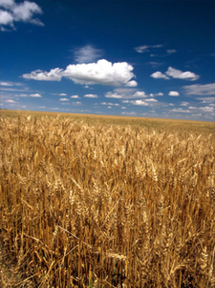
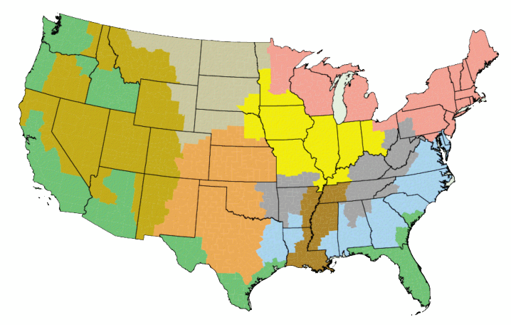

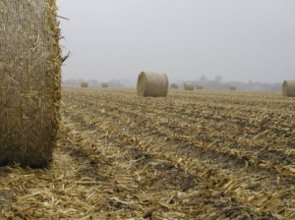
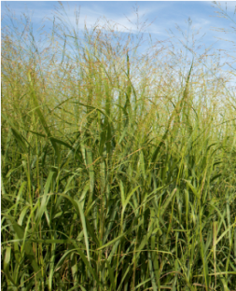
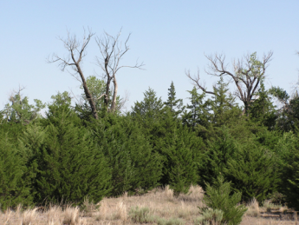
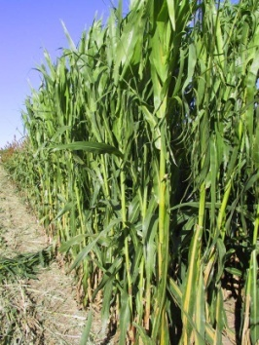


Concentrate on Specific Regional Feedstocks
Crop residues
Perennial grasses
Energy cane
Non-food biomass sorghum
Lipid seed crops
Woody Biomass
Invasive rangeland trees
No one feedstock will meet all national biofuel needs

Slide 19
USDA Research Efforts
AFRI – CAPs
  The Agriculture and Food Research Initiative (AFRI) funds Coordinate d Agricultural Projects (CAPs) that integrated research, extension, and education grants that address key problems of National, regional, and multi-state importance in sustaining all components of agriculture, including farm efficiency and profitability, ranching, renewable energy, forestry (both urban and agroforestry), aquaculture, rural communities and entrepreneurship, human nutrition, food safety, biotechnology, and conventional breeding.
  Challenge Area: Develop regional systems for the sustainable production of biofuels, biopower, and biobased products to enhance existing agricultural systems and provide alternatives to fossil-based fuel and products to extend the availability of these finite feedstocks and partially address environmental impacts.
  Five year consortia projects with transdisciplinary systems approach. Partnerships, economic, environmental, and social assessment.

Slide 20
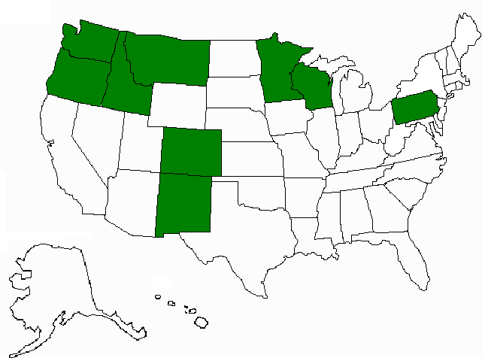
Northwest Advanced Renewables Alliance (NARA): New Vista for Green Fuels, Chemicals, and Products
WA St U, $40,000,000 (5 years)
41 Key Personnel representing 9 Universities, 3 Federal Partners, and 4 Industrial Partners from 9 States:
  Renewable aviation fuel, value-added industrial chemicals
  Woody biomass residues
    Weyerhaeuser, other landowners
    Bioconversion and fuel production
    Gevo, Catchlight

Slide 21
USDA Programs
Technical and Financial Assistance
Farm Bill Title IX Programs
  Federal Procurement of Biobased Products (9002)
  Biorefinery Assistance Program (9003)
  Repowering Assistance Program (9004)
  Bioenergy Program for Advanced Biofuels (9005)
  Rural Energy for America Program (REAP - 9007)
  Biomass Research and Development (9008)
  Biomass Crop Assistance Program (9011)
  Community Wood Energy Program (9013)

Slide 22
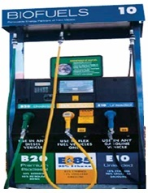
Section 9003 - Biorefinery Assistance Program
Investments in “First of its kind” commercial production
Loan Note Guarantees issued:
  Sapphire Energy, Inc., New Mexico, $54.5 million REPAID
  INEOS New Planet BioEnergy, Florida, $75 million
Conditional Commitments awarded:
  Enerkem Corporation, Mississippi, $80 million
  Zeachem, Oregon, $232.5 million
  Fiberight, Iowa, $25 million
  Fulcrum Sierra Biofuels, Nevada, $105 million
  Chemtex, North Carolina, $99 million

Slide 23
USDA Partnerships
Defense Production Act
Farm to Fleet Program
Biomass research and Development Initiative
Joint USDA/DOE initiative (BRDI) $40M
Interagency Groups
Interagency Working Group on Alternative Fuels
  DOE
  FAA
  EPA

Slide 24
USDA Partnerships - continued
Public-private partnerships
Farm to Fly Initiatives (V1 and F2F2)
CAAFI – Commercial Aviation Alternative Fuels Initiative
MASBI – Midwest Aviation Sustainable Biofuels Initiative
Notes:
How do we do this – what is our approach
Partnerships
We work closely with other federal agencies and offices through the Interagency Working Group
DOE and USDA co-chair the Biomass Research and Development Initiative and with DoT, Defense, subgroups working on infrastructure, logistics , and feedstock genetics
USDA works closely with the EPA – feedstock pathways, provide input for RFS volumes
Working with the Navy and DOE on DPA initiative
FAA – FSRL
FAA and others RD3

Slide 25
THANK YOU

Slide 26
CAAFI 2014
General Meeting
& Expo
Jonathan Male,
Deputy Director, BETO, DOE
Produced by

Slide 27
Commercial Aviation Alternative Fuels Initiative General Meeting
January 28th, 2013
Jonathan L. Male
Director, Bioenergy Technologies Office

Slide 28

The Clean Energy Race: In It to Win It
  “The path towards sustainable energy sources will be long and sometimes difficult. But America cannot resist this transition, we must lead it. We cannot cede to other nations the technology that will power new jobs and new industries, we must claim its promise…”
  -President Obama, Inaugural Address, January 21, 2013
Official White House Photo by Lawrence Jackson
Notes:
At the beginning of any President’s second term, there are always questions about what his priorities are going to be.
President Obama left no room for misinterpretation during his Inaugural Address and during the State of the Union – he is in it to win it when it comes to clean energy.
Back in January he said,
“The path towards sustainable energy sources will be long and sometimes difficult. But America cannot resist this transition, we must lead it. We cannot cede to other nations the technology that will power new jobs and new industries, we must claim its promise…”
Clean energy will continue to be one of this Administration’s highest priorities, so there is going to be a lot of very exciting and important work ahead of us at the Department.

Slide 29



Bioenergy Technologies Office
A viable, sustainable domestic biomass industry that:
Produces renewable biofuels, bioproducts, and biopower
Enhances U.S. energy security
Reduces U.S. dependence on oil
Provides environmental benefits, including reduced GHG emissions
Creates economic opportunities across the nation
Vision
Develop and transform our renewable biomass resources into commercially viable, high-performance biofuels, bioproducts, and biopower through targeted research, development, demonstration, and deployment (RDD&D) that is supported through public and private partnerships
Mission
Develop commercially viable biomass technologies to enable the production of biofuels nationwide and reduce dependence on foreign oil through the creation of a new domestic bioenergy industry, thus supporting the Energy Independence and Security Act (EISA) of 2007 goal of producing 36 billion gallons per year of renewable transportation fuels by 2022
Strategic Goals

Slide 30
Bioenergy Technologies Office Overview (BETO)
Mission: Through targeted RDD&D, enable sustainable, nationwide production of advanced biofuels that that will displace a share of petroleum-derived fuels, mitigate climate change, create American jobs, and increase U.S. energy security.
Research, Development, Demonstration, & Deployment
Cross Cutting
Feedstock Supply
Develop sustainable, secure, reliable, and affordable biomass feedstock supply.
Conversion R&D
Develop commercially viable technologies for converting biomass feedstocks into fungible, liquid transportation fuels, bioproducts and chemical intermediates
Demonstration & Deployment
Demonstrate and validate integrated technologies with successful construction and operation of cost-shared pilot, demonstration, and commercial scale facilities
Sustainability
Promote the positive economic, social, and environmental effects, while reducing potential negative impacts of biofuels
Strategic Analysis
Provide context for decisions by establishing quantitative metrics, tracking progress toward goals, and informing portfolio planning and management
Notes:
Where does EERE comes in – well our very mission is to support American leadership in the global transition to a clean energy economy.
What I mean by this is that while we know clean energy is cheaper for society when all real costs are considered, to succeed in the market it should also be as affordable and convenient to the consumer as traditional forms of energy.
And this is the goal of the Bioenergy Technologies Office’s high-impact research, development, and deployment…
Research into feedstock supplies that are cost competitive and sustainable, and don’t impact our ability to produce food
Reducing barriers to efficient and effective conversion technologies that can convert domestic resources into products that displace imported petroleum.
And of course reducing the risk of deployment through direct funding and loan guarantees to spark private investment moving technologies through all the stages of development necessary to create new products and markets

Slide 31
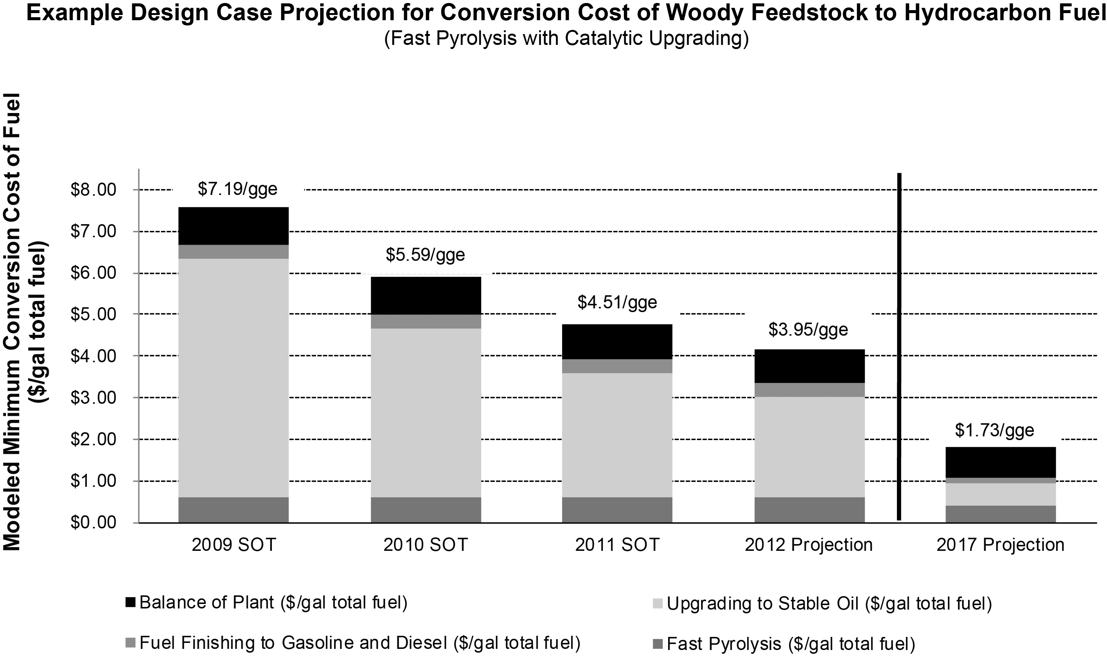
BETO’s Role
RDD&D
BETO supports R&D to prove out technical concepts, and overcome barriers to lower costs of advanced hydrocarbon biofuels making them cost-competitive with petroleum fuels
BETO supports D&D to de-risk new technologies through validation of proof-of-performance at the pilot, demonstration and pioneer scale, in order to enable investor confidence for commercial investment

Slide 32
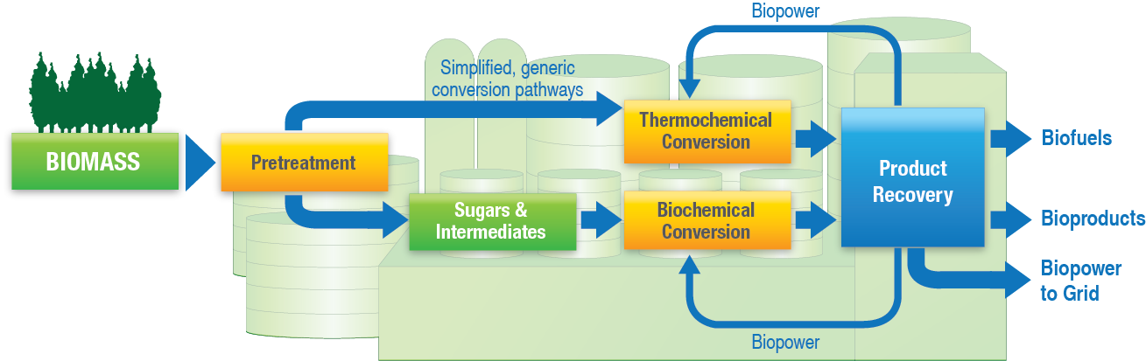
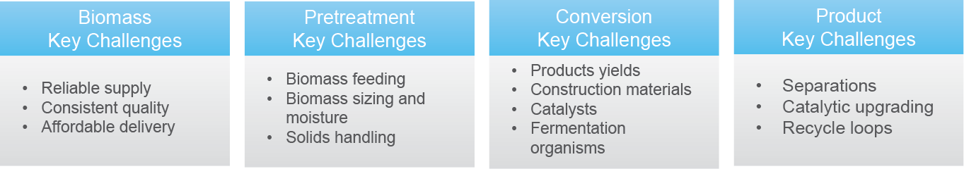
Innovation is Challenging and Involves Risks
De-risking of technologies is central to R&D into and through the D&D role, addressing greater integration and scale:
  BETO is focusing on advancing more technologies, including renewable diesel and jet fuels
  Technical, construction, operational and financial/market risks
  DOE needs new ways to communicate technical risk for hydrocarbon fuels
Notes:
For the past decade, the program has focused on RD&D to reduce the cost of production of cellulosic ethanol. In September 2012, scientists at DOE’s National Laboratories successfully validated through a pilot scale demonstration, feedstock and conversion processes that reduced the cost of production of cellulosic ethanol.
The Bioenergy Technologies Office (BETO) has been working with national labs, industry stakeholders, and airline partners to look at new research developments and market opportunities for renewable aviation fuels. As new pathways are meeting the American Society for Testing and Materials (ASTM) standards the airline industry is focusing even more on the commercialization of sustainable biofuels for aviation use. http://www.caafi.org/information/pdf/CAAFI_DOE_costworkshop_Fact_Sheet.pdf

Slide 33
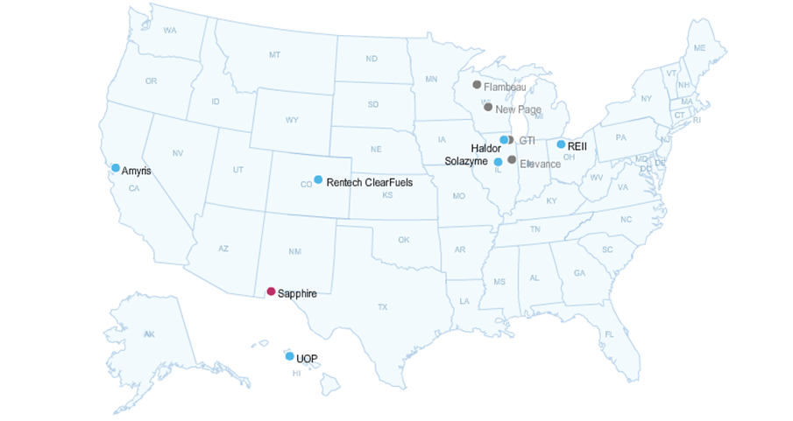
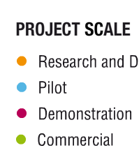
BETO IBR Portfolio and Hydrocarbon Fuels
11 integrated biorefinery projects are investigating hydrocarbons from biomass resources:
  Flambeau
  New Page
  Haldor
  GTI
  REII
  Elevance
  Solazyme
  ClearFuels
  Amyris
  Sapphire
  UOP
GTI and Elevance are R&D projects.
9 projects are pilot, demonstration, or commercial scale.
For more information visit: http://www1.eere.energy.gov/bioenergy/integrated_biorefineries.html
Notes:
BETO works through public-private, cost-sharing partnerships to address critical challenges in the deployment of technologies for integrated biorefineries. These partnerships undertake biorefinery projects to prove the viability of various feedstock and conversion pathways and reduce technical and financial risks. The projects typically follow a progression from pilot to demonstration scale and from demonstration to commercial scale. Each step in this progression enables validation of production performance at scale, paving the way for commercial readiness.
The commercial aviation fleet uses approximately 20 billion gallons per year of jet fuel. In order to achieve the requirements for the military and commercial aviation fleets, process technologies that will convert cellulosic biomass to renewable hydrocarbon fuels is essential to the national and economic security of the country.

Slide 34
Aviation Biofuels
BETO is committed to strengthening the relationship between the DOE and the aviation sector in order to help advance the renewable jet fuel industry. Over the past few years, BETO has increased collaboration activities with the military, airline industry, and government partners including the Commercial Aviation Alternative Fuels Initiative (CAAFI) and the Federal Aviation Administration (FAA).
As part of the increasing aviation fuels focus at the DOE, BETO staff will be supporting the following initiatives:
National Alternative Jet Fuels Strategy Roadmap
FAA Center of Excellence in alternative jet fuels
Alternative Jet Fuels Workshop (a follow up to November 2012 effort)
Notes:
There is an increasing need for technical work to support the advancement of jet fuels. BETO has supported applied research to develop, scale up and commercialize advanced aviation biofuel technologies. Working with the National Laboratories, BETO has started to look into LCA, TEA, and other key analysis impacts for alternative jet fuel.
A good portion of the research and development geared toward the production of renewable hydrocarbons support efforts to produce cost competitive aviation fuels.
Beyond this DOE is working with the commercial aviation sector to identify ways to collaborate…
For example, in November 2012 – An initial workshop was held (jointly hosted with FAA and CAAFI) which focused specifically on the cost of production for renewable jet fuels, and brought together DOE technologists and techno-economic modeling experts, jet fuel customers (commercial and military), aerospace research professionals, and technical experts to examine the issues involved across the whole supply chain. This allowed our experts to work with the correct set of customers to understand the needs of the industry

Slide 35
Natural Gas
Recent Developments
  BETO has received several requests from industry to investigate whether a combination of natural gas and biomass could be utilized to produce liquid transportation fuels (particularly aviation fuel) and products.
  Two biofuels companies have announced their intention to abandon biomass as a feedstock and utilize natural gas to produce liquid fuels.
DOE Workshop on Natural Gas-Biomass Technologies
  BETO, in coordination with the Office of Fossil Energy and ARPA-E, hosted a one-day workshop addressing natural gas-biomass-to-liquids (GBTL) research needs and technology options in September, 2013.
  Objective of this event was to obtain input from industry, academia, research establishments, and other experts on whether or not there is a role for DOE to conduct R&D and develop new process technologies.
  On February 6th, BETO will host a webinar discussing the results of this workshop, and the summary report will be posted this spring.
Notes:
The recent development of the increased availability of low cost natural gas has increased opportunities to consider the use of natural gas as a feedstock for conversion into liquid hydrocarbons (GTL), and co-conversion of natural gas with biomass (GBTL) has the potential of increasing yield of liquid product while also having lower greenhouse gas emissions relative to petroleum.
Advantages of using natural gas in bioenergy technologies include diversification of feedstocks, increased flexibility of feedstock supply issues, and allowing companies to hedge prices. Economics of process combined with tradeoff of GHG, understanding tradeoffs.
DOE is looking into better understanding some of the research challenges and key takeaways from the September Workshop, including down-scaling issues, avalibility of stranded NG/Feedstocks, catalyst improvement, and other considerations for alternative fuels (particularly jet and diesel)
Companies currently investigating new technologies using NG: Primus, Sundrop, Coskata, LanzaTech,

Slide 36
Demonstration and Deployment Workshop
BETO is interested in identifying the next step(s) in drop-in hydrocarbon biofuel production. A spring workshop is being planned to discuss, reassess, and prioritize the demonstration and deployment efforts needed to realize affordable, scalable, and sustainable production of hydrocarbon biofuels.
D&D Strategy Workshop will be held on March 12-13, 2014 at Argonne National Laboratory’s ANS conference center in Chicago, Illinois.
Attendees will discuss the current state of technology and efforts needed to achieve affordable, scalable, and sustainable drop-in hydrocarbon biofuels.
The outcomes of these discussions are expected to result in the following:
  Determine how BETO can accelerate industry’s efforts
  Develop strategy and future plans
  Led to a breakout session at the Biomass 2014 Conference on July 29-30th
For updates and further information, please visit the Demonstration and Deployment Workshop Web page (http://www1.eere.energy.gov/bioenergy/demonstration_deployment_strategy_workshop.html)
Notes:
The Bioenergy Technologies Office's Demonstration and Deployment Program is hosting a workshop to discuss the current state of technology and efforts needed to achieve affordable, scalable, and sustainable drop-in hydrocarbon biofuels.
As the biofuel industry begins to advance commercial-scale cellulosic ethanol technologies, BETO is looking to take the next step in demonstrating the production of drop-in hydrocarbon biofuels. This
The outcomes of these discussions are expected to result in the following:
Determine how BETO can accelerate industry’s efforts
Develop strategy and future plans
Lead to a breakout session at the Biomass 2014 conference on July 29-30th
The workshop will include sessions on past demonstration and deployment successes, lessons learned, goals, research strategies, and facilitated breakout sessions.

Slide 37
FY2014 Priorities
Feedstock Logistics: Reduce the feedstock logistics cost target for delivery to plant from $55/dry-matter ton to $53/dry-matter ton for loblolly pine
Algae and Advanced Feedstocks: Reduce the modeled mature plant cost of open pond algal oil by $2.35 to $14.31/gasoline gallon equivalent (gge) by improving overall algal biomass productivity toward the $3.00/gge in 2022 goal
Biochemical Conversion: Define priority pathways for hydrocarbon fuel development and initiate two new programs beyond fuels: waste-to-energy and use of lignin and lignocellulosic sugars to produce carbon fibers
Thermochemical Conversion: Reduce the modeled conversion cost from $3.18/gge to $2.70/gge for producing gasoline/diesel from biomass by way of pyrolysis or direct liquefaction technologies followed by catalytic upgrading
Incubator Program: Support innovation by providing small businesses with increased access to BETO’s funded capital and user facilities
Integrated Biorefineries: Advance portfolio of innovative pilot-scale and demonstration-scale biorefineries for biofuel and bioproducts manufacturing
Analysis and Sustainability: Conduct cross-cutting and systems-level analyses to inform program planning, decision-making, and R&D investments; evaluate sustainability metrics and promote best practices regarding productivity, land use, water, emissions, and social sustainability
Biopower/Cookstoves: Emphasize R&D and validation of cookstoves; improve combustion and heat transfer processes through a competitive process
Notes:
In FY 2014, several new competitive awards will be made that span the entire program portfolio.
In conversion R&D benefiting multiple pathways to cost competitive hydrocarbon fuels, with pathways for jet and diesel, will be pursued . FOAs will target fundamental improvements in separations and catalysis, as identified in previous road mapping workshops.
A solicitation focused on purpose-designed biomass feedstock supply chains addressing biomass stability, densification, and quality and conversion performance aims to reduce the delivered cost of a variety of feedstocks to biorefineries. In addition, the program will award additional projects from a solicitation to promote algal strain improvement and domestication, crop protection strategies, regionally and seasonally specific cultivars, and nutrient management techniques to improve algae productivity
Also through competition, the program will explore the feasibility of producing clean characterized sugars from biomass at reasonable cost (less than $0.15–$0.20/lb.) and cost-effective sugar upgrading to fuels and bio-products.
Several significantly new areas of research will also be pursued

Slide 38
Backup Slides

Slide 39
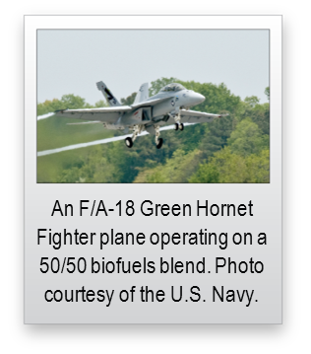
Bioenergy Technologies Office Awards
Innovative Pilot and Demonstration Scale Production of Advanced Biofuels
On April 22nd, the Department of Energy announced the four projects selected for negotiation for the innovative pilot FOA for the production of advanced biofuels. Each project that was selected will be working to produce biofuels that meet military specifications for jet and diesel fuel.
  Frontline Bioenergy LLCM, Ames, Iowa
    Up to $4.2 million to produce FT liquids from woody biomass, municipal solid waste, and refuse derived fuel. These liquids will be upgraded to produce samples of biofuels that meet military specifications.
  Cobalt Technologies, Mountain View, California
    Up to $2.5 million to operate a pilot-scale integrated biorefinery to convert switchgrass to bio-jet fuel
  Mercurius Biorefining, Inc., Ferndale, Washington
    Up to $4.6 million to operate a pilot plant converting cellulosic biomass into drop-in bio-jet fuel and chemicals.
  BioProcess Algae, Shenandoah, Iowa
    Up to $6.4 million to produce hydrocarbon fuels meeting military specifications from an algae-based integrated biorefinery.

Slide 40
Next Steps: Technology Pathways Development
In 2012, eight technology pathways to hydrocarbon biofuels were selected based on the following criteria:
Feasibility of achieving cost goal of $3/gal
Near/mid/long-term techno-economic potential
Potential national impact
Feedstock availability/flexibility
Data availability across the full pathway
Co-product economics
Environmental sustainability
Technology Pathways
Biological Conversion of Sugars to Hydrocarbons
Catalytic Upgrading of Sugars to Hydrocarbons
Ex-situ Catalytic Pyrolysis
In-Situ Catalytic Pyrolysis
Fast Pyrolysis and Upgrading
Syngas to Mixed Alcohols to Hydrocarbons
Whole Algae Hydrothermal Liquefaction
Algal Lipid Extraction Upgrading to Hydrocarbons
Next Steps: Identify cost goals and technical targets and develop design case reports for each pathway
Notes:
In 2012, the Office completed high level TEA on 13 potential pathways to hydrocarbon fuels and selected 8 priority technology pathways based on the following criteria:
Feasibility of achieving cost goal of $3/gal
Near/mid/long-term techno-economic potential
Potential national impact
Feedstock availability/flexibility
Data availability across the full pathway
Co-product economics
Environmental sustainability
As you can see there are a wide array of potential pathways, each with benefits and drawbacks.
Ex situ – two step catalysis of vapors
In situ – one step catalysis of vapors before condensation

Slide 41

Aviation Biofuels Techno-Economic Analysis Workshop
When: November 27th, 2012 Where: Washington, DC
Workshop Objectives
  Benchmark current and future cost-of-production and performance characteristics of biomass-based processes that can produce jet fuel
Scope
Processes
  New pathways for aviation fuels
  Biochemical conversion
  Thermochemical conversion
  Algae-derived methods
  HEFA/HEFA algae
  Gasification/FT
Feedstocks
  Productivity and handling

Slide 42
Aviation Biofuels Workshop Summary
Workshop provided a unique opportunity for stakeholders to discuss cost of biofuels production via multiple pathways.
Challenge to make this knowledge accessible. Research results and data needs to be more broadly communicated; greater awareness of ongoing R&D is needed.
As fuels are being qualified, costs should be considered. Fuel producers and key stakeholders should be brought into this process.
Data from facilities under construction is difficult to obtain (IP, etc.), however, it is needed to provide a reality check.
Common terms, units, and techniques are needed for techno-economic analysis to enable consistent comparison of technologies.
Presentations at http://www1.eere.energy.gov/biomass/meetings.html, summary fact-sheet at http://www.caafi.org

Slide 43
CAAFI 2014
General Meeting
& Expo
Chris Tindal,
Director for Operational Energy, Office of the DAS of the Navy for Energy, Navy
Produced by

Slide 44

DEPARTMENT OF THE NAVY
Advanced Biofuels Update
Chris Tindal
Director for Operational Energy

Slide 45





Pacific Ocean USS Princeton (CG 59) pulls oiler USNS Henry J. Kaiser (T-AO 187)
Royal Australian Navy S-70B Sea Hawk helicopter
2012 GGF DEMONSTRATION
PACIFIC OCEAN (July 18, 2012)
SECNAV and CNO aboard USS Chafee
USS Princeton (CG 59) ,USS Nimitz (CVN 68)

Slide 46
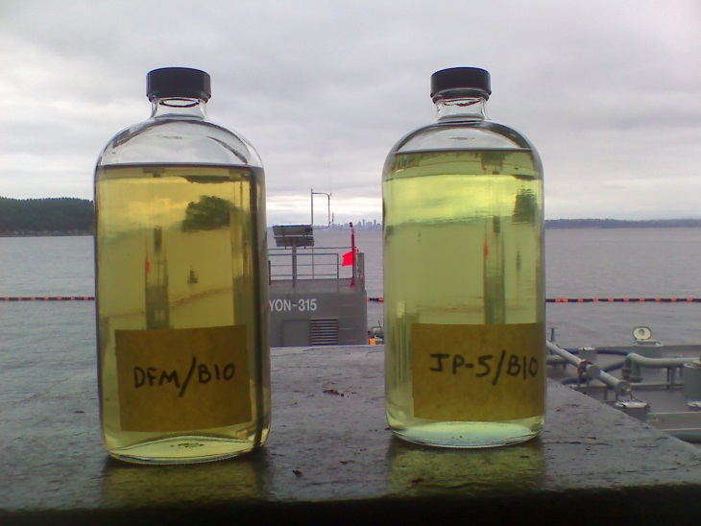
DPA Title III Advanced Drop-In Biofuels Production Project
As of June 19, 2013, 4 Phase 1 awards have been made
Potential for 170 million gallons of drop-in compatible MILSPEC fuels (F-76, JP-5, JP-8) to start production by 2016
Weighted average price in 2013 dollars < $4/gal
Project has $100 million in FY12 funds from DOD, $60 million in FY13 from USN that can’t be reprogrammed
USDA has contributed $161 million in CCC funds
Phase 2 awards set to begin July 2014
  Construction and commissioning

Slide 47


Farm to Fleet Biofuels Initiative
Start on biofuels acquisitions for Great Green Fleet 2016 & SECNAV’s 2020 goals (336 MM gal)
Use DLA Energy bulk petroleum contracting to begin large-scale, domestic drop-in biofuel purchases for regular operational use
USDA CCC funds can be used to help defray feedstock costs
Solicitations pending (spring 2014)
Deliveries scheduled to begin:
  April 2015 with the Inland/East/Gulf Coast region
  June 2015 for Rocky Mountain/ West Coast region
  These two solicitations cover all 50 states

Slide 48
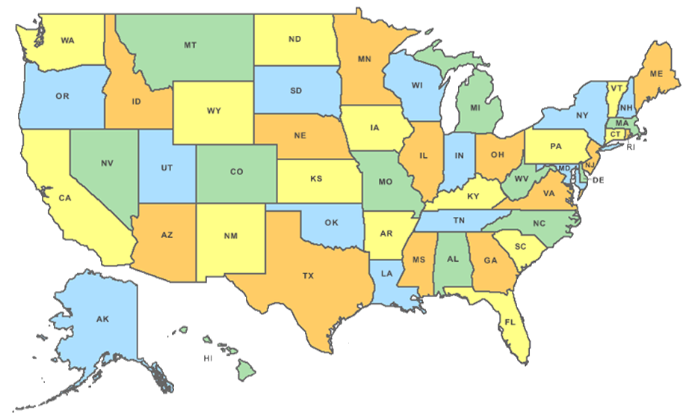
Rocky Mountain/West Coast
Inland/East/Gulf Coast
Puerto Rico
Guantanamo Bay
Bermuda
Panama Canal Zone
Wake Island
Kwajalein

Slide 49

Farm to Fleet Biofuels Initiative
10% blend target, 1 year contracts
  10% ≈ 43 + 37 MM gal (neat) for each solicitation (≈ 80 MM total)
  JP-5 jet fuel and F-76 diesel fuel marine – FT and HEFA
CCC Eligibility
  Feedstocks consistent with CCC charter
Feedstock Preferences
  Navy is feedstock agnostic; targets finished fuel specifications
  Not to interfere with food production
GHG emissions
  EISA 526 dictates same or better GHG emissions
Price: Will be biggest decision criteria; must be cost competitive
Farm to Fleet Industry day January 30th

Slide 50
Farm to Fleet Industry Day
The meeting will be held on Thursday, January 30, 2014, from 8:00 a.m. to 5:00 p.m.
The meeting will be held at USDA Jefferson Auditorium, USDA South Building, 14th and Independence, Washington, DC 20250.
This session is neither intended to offer government insight, nor to answer direct questions and receive comments on bulk fuel purchases held by DLA Energy. Questions related to DLA Energy bulk fuel contracting cannot be answered at this venue.

Slide 51
Farm to Fleet Industry Day
The event is free, however all attendees must register for the Farm to Fleet Industry Day via email Farm2Fleet.IndustryDay@gmail.com with all of the following required information:
  Name and Title:
  Corporate Affiliation:
  Address:
  Phone Number:
  Email:
  Web Site:
  Position on the Biofuels Production Value Chain: (i.e., feedstock provider, bio-refiner, blender, finished products distributor, subject matter expert, financier, etc.)

Slide 52

THANK YOU
F/A-18E
Mt. McKinley, Alaska

Slide 53
CAAFI 2014
General Meeting
& Expo
Karl Simon,
Director, Transportation and Climate Division, OTAQ, EPA
Produced by

